Slide 1


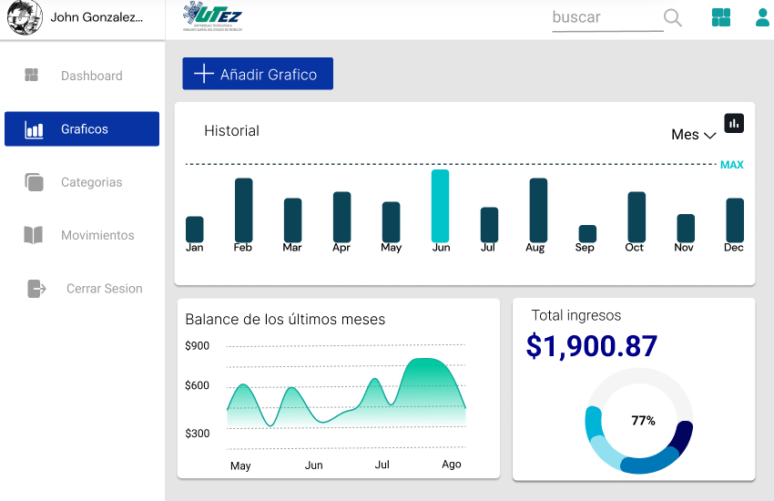
Sistema Personal Contable
Cliente: David Iván Pérez Torres
Integrantes:
Cano Chino Ana Paola
Delgado Velázquez Josué Jafet
García Ortiz Angelo Daniel
González Hernández Juan Diego
Moctezuma Montoya Isaac
Vázquez Sotelo Diego Alexis

Slide 2
Description
Our project is a personal accounting system which consists of creating a platform or software that will allow users to manage and track their personal finances efficiently and accurately.
In addition, the system must be intuitive and easy to use, allowing users to access their financial information quickly and easily.
Start date: 11-05-23 End Date: 13-ago-23

Slide 3
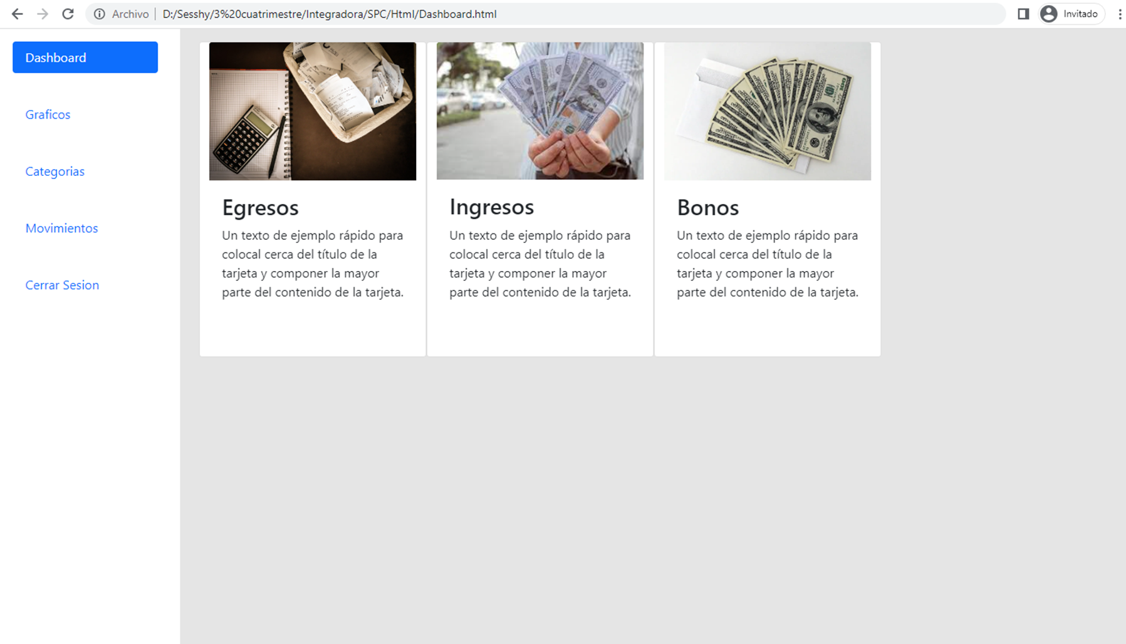
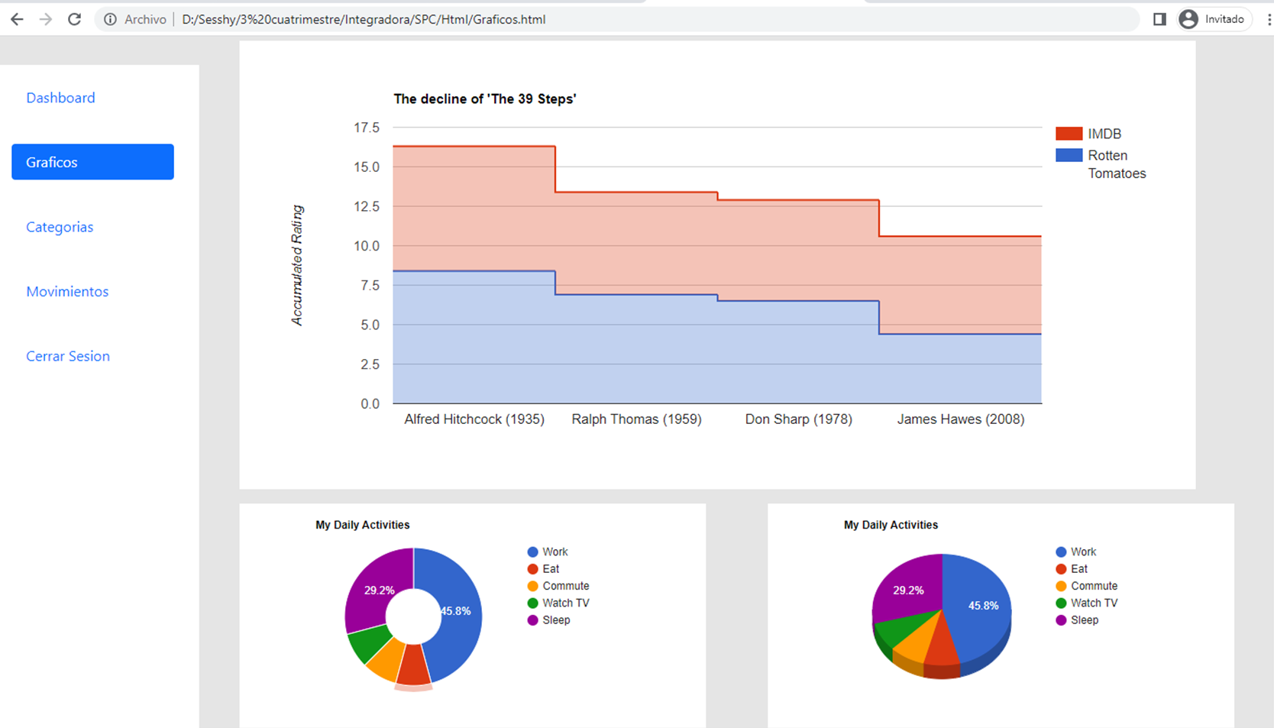
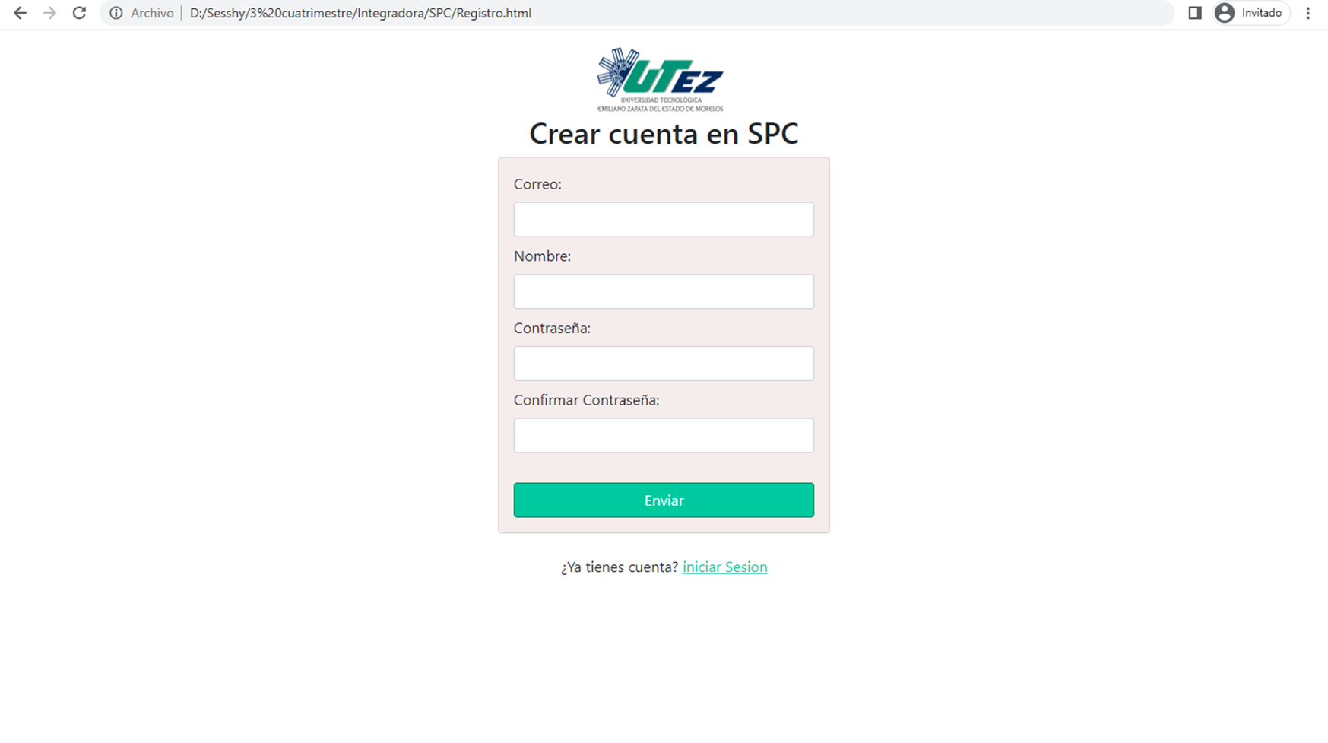
Implemented modules
Login
Registration
Dashboard
Graphics
Categories
Movements
Log out

Slide 4



Implemented communication tools

Slide 5

Customer Deliverables
Project charter
DFR.
Project prototypes
User Manual
Installation Manual
Maintenance Manual
Database Script
Functional System

Slide 6
Project Objective
The objective of our project is to create a system capable of automating tasks for better financial management, tasks such as the recording of income and expenses, the categorization of transactions and the generation of financial reports.

Slide 7

Justification
Our project is based on the need to have a tool that allows users to keep track of and control their personal finances efficiently and effectively.
At present, the administration of personal finances is a fundamental aspect for the economic stability and well-being of people. However, it is often difficult to keep a detailed track of income and expenses, as well as the different assets and liabilities that you have.
Thanks to our project, we will offer important benefits to our users, since we will allow them to correctly manage their financial resources, plan and make more informed and effective decisions about what to do with their money.

Slide 8
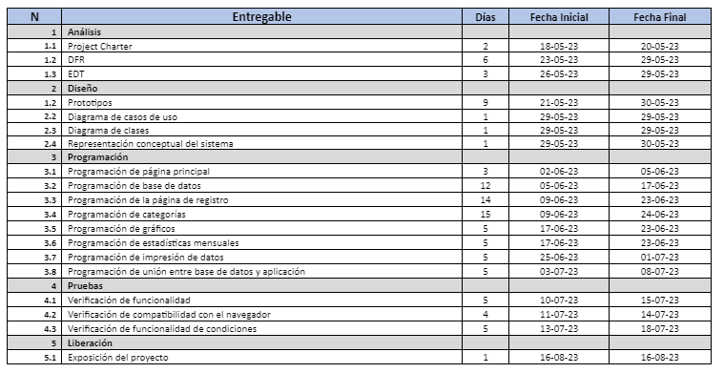
Schedule

Slide 9
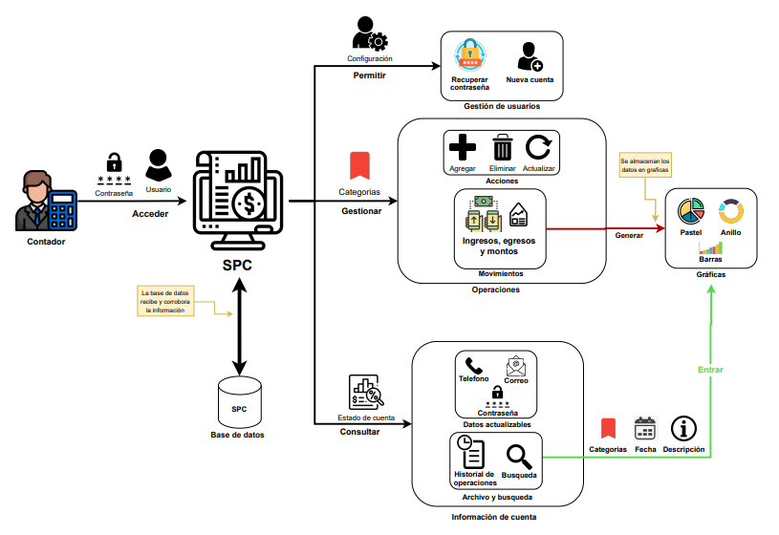
Conceptual representation

Slide 10
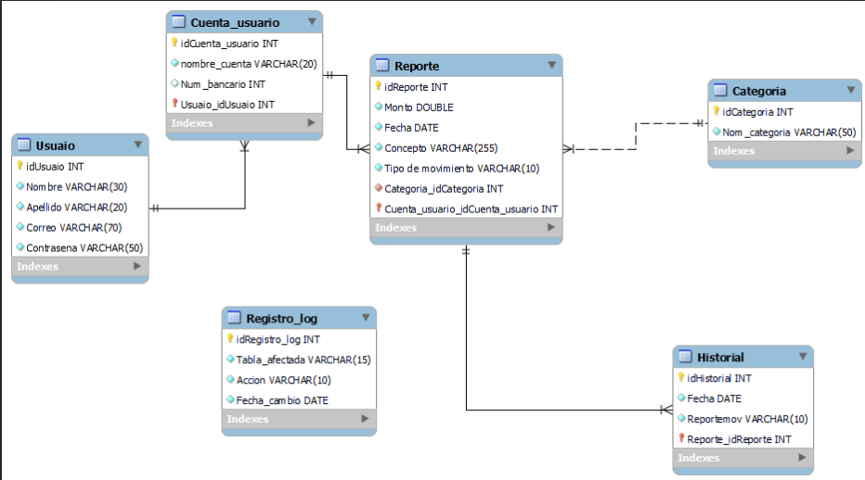
Physical model of the database

Slide 11
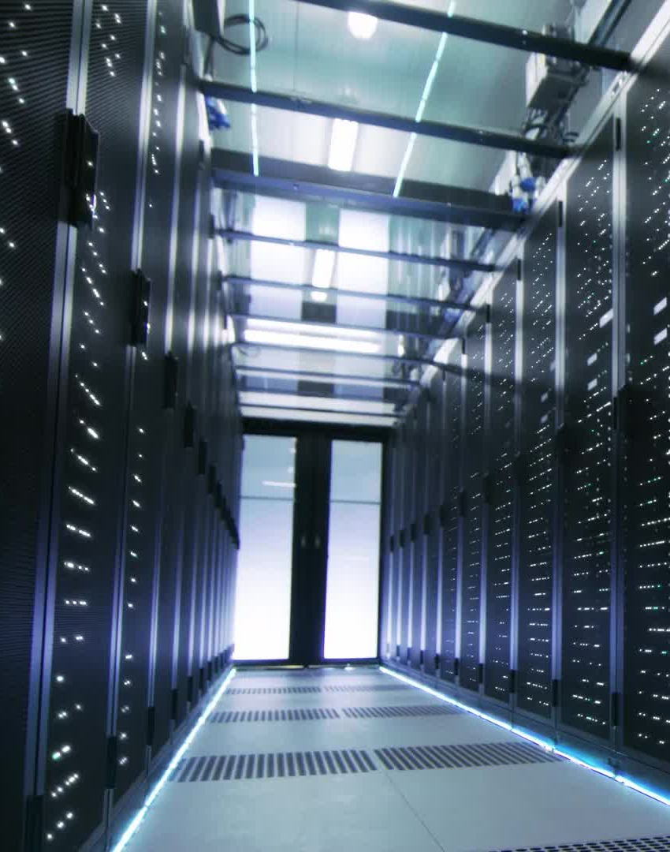
Possible risks and Solutions
Not being able to successfully connect to the database.
The server stops working
Not meeting customer expectations
Not fulfilling what was previously promised
Not being able to finish the project on time.

Slide 12

Advantages of using our system
Organization and classification of information
Budget Control
Long-term financial planning
Reporting and analysis

Slide 13


Lessons learned
Better organization
Better communication
Have time
Improve performance
Ask for help
Better information collection

Slide 14

System Testing

Slide 15

Conclusions
In conclusion, the development of our personal accounting system project (SPC for its acronym in Spanish), is justified by the need to have a tool that facilitates the efficient management and control of personal finances. By providing a clear vision of income and expenses, our system allows for better financial planning and decision-making, thus helping the well-being and economic stability of users.

